Slide 1

How to open and manage a bcc junior card
How to register in the JuniorBank app

Slide 2

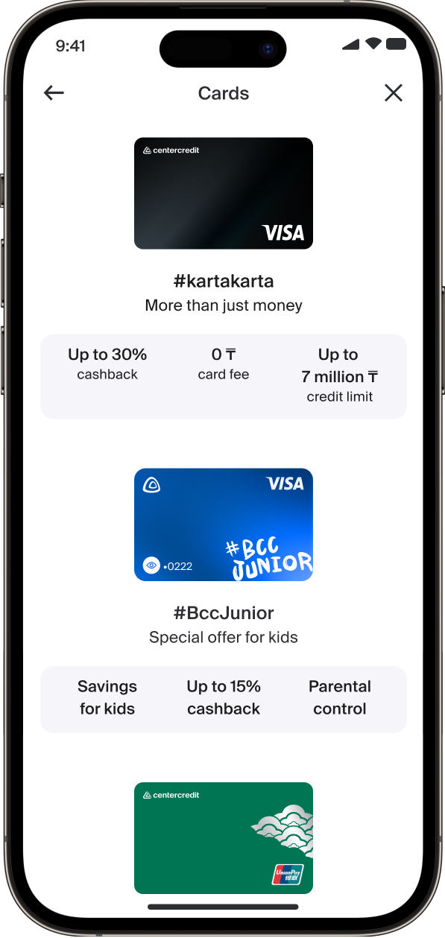
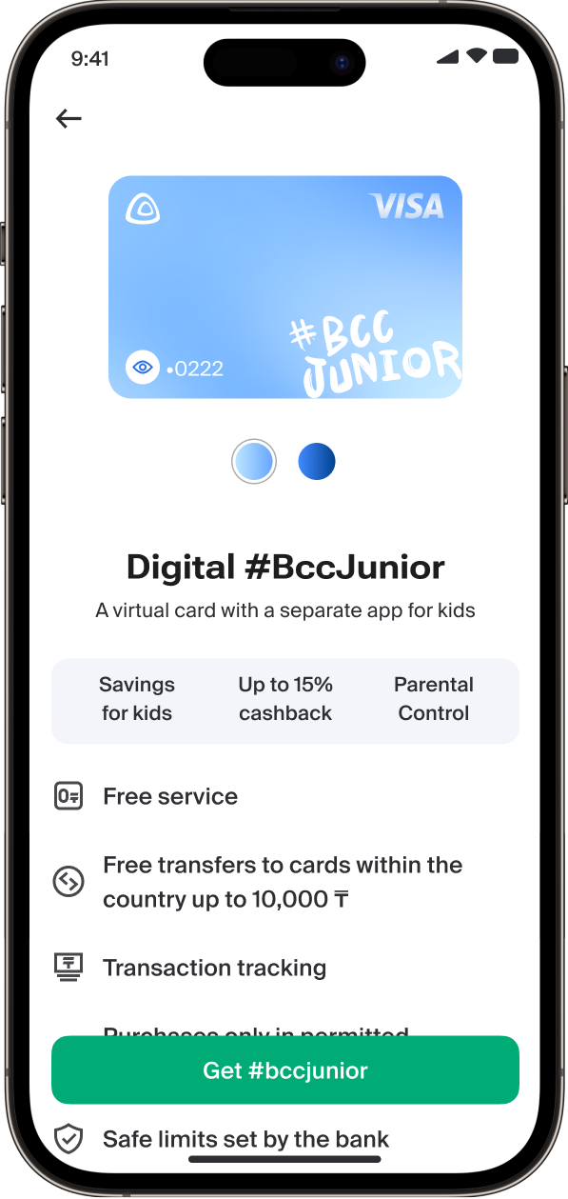
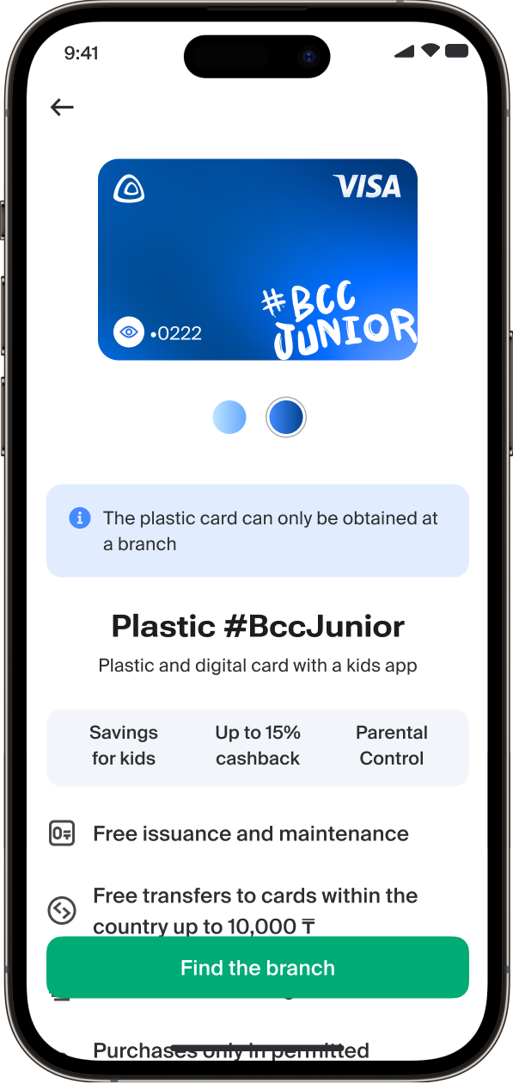
How a parent can open a bcc junior card on bcc.kz
Go to “Cards” in the “Services” section
and choose a card to open
A digital card can be issued online
A plastic card can only be issued at a branch

Slide 3
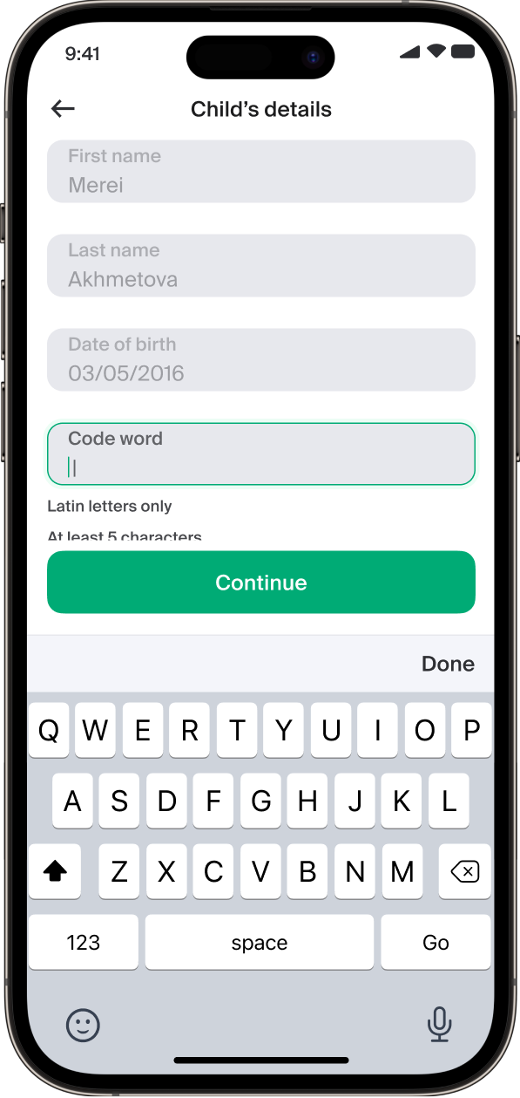
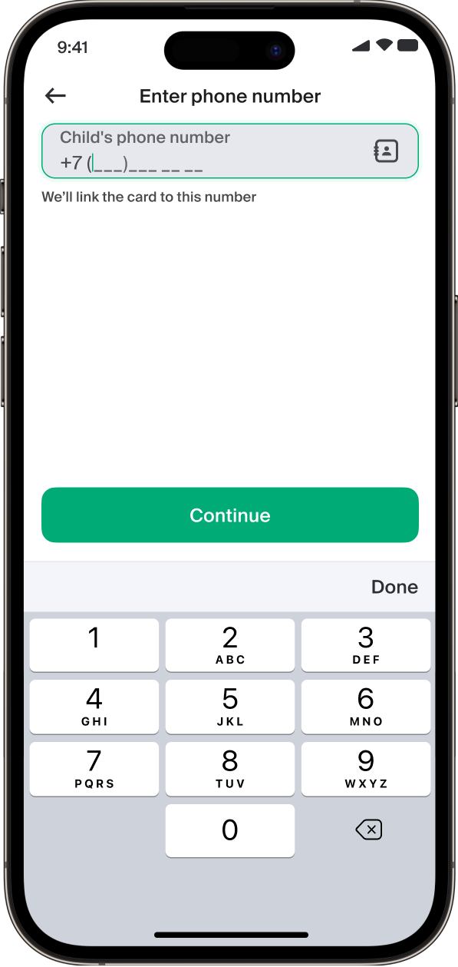
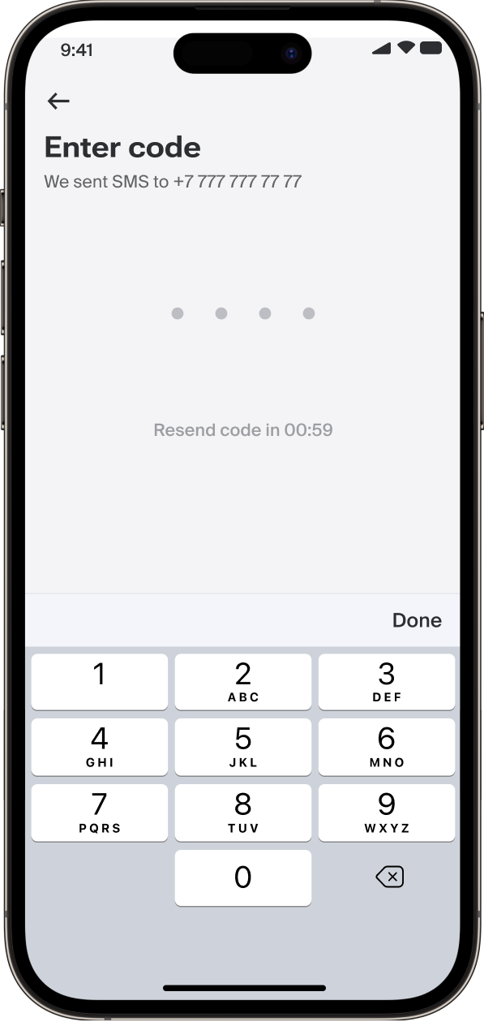
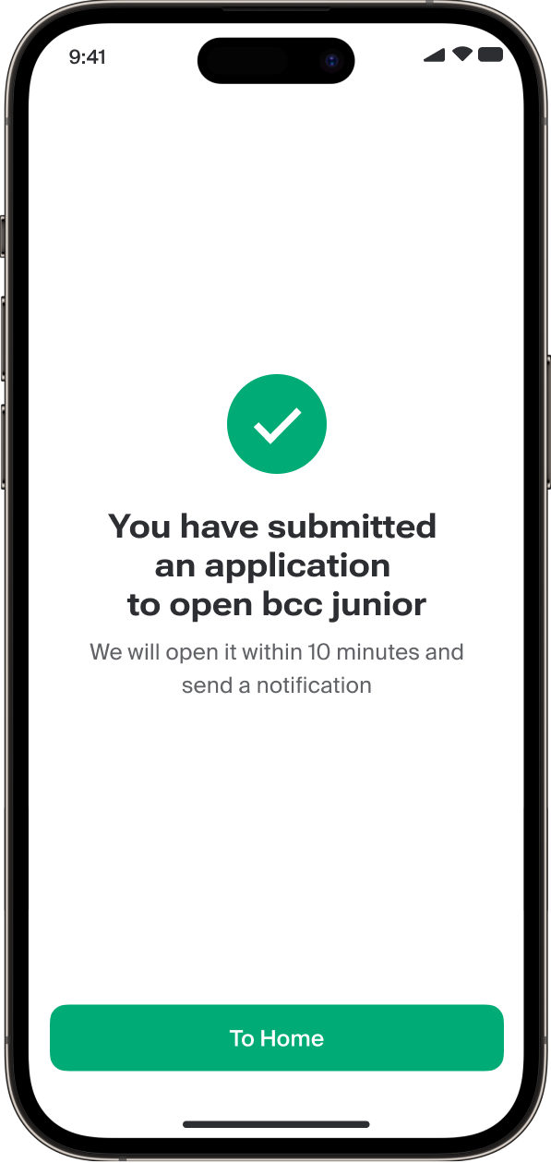
Enter the child’s ID (IIN)
and a code word
Enter the phone number
Enter the SMS code
Application submitted

Slide 4
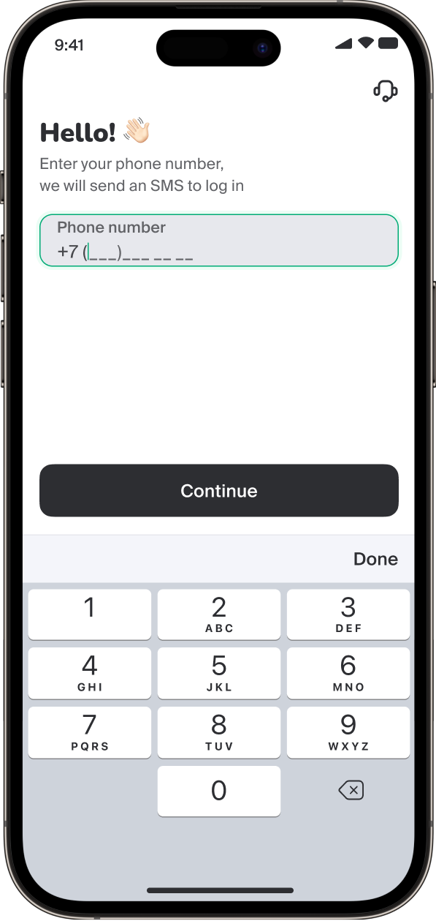
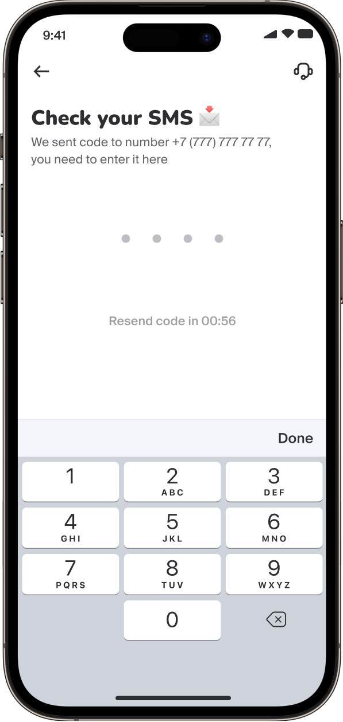
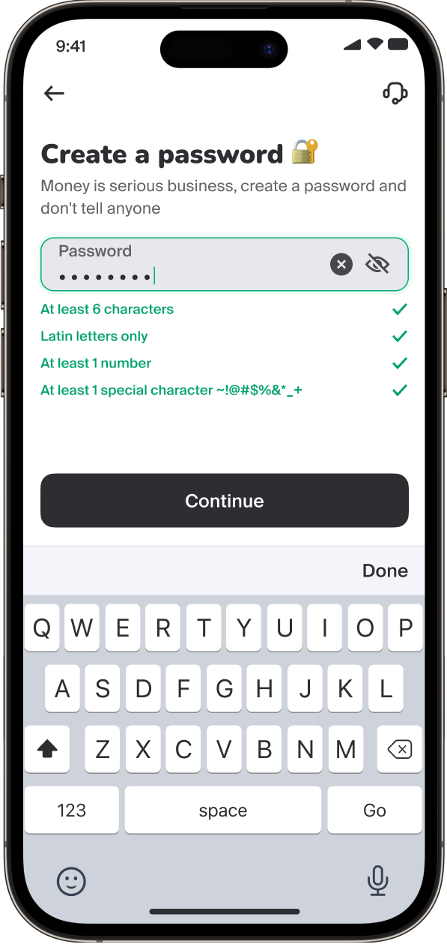
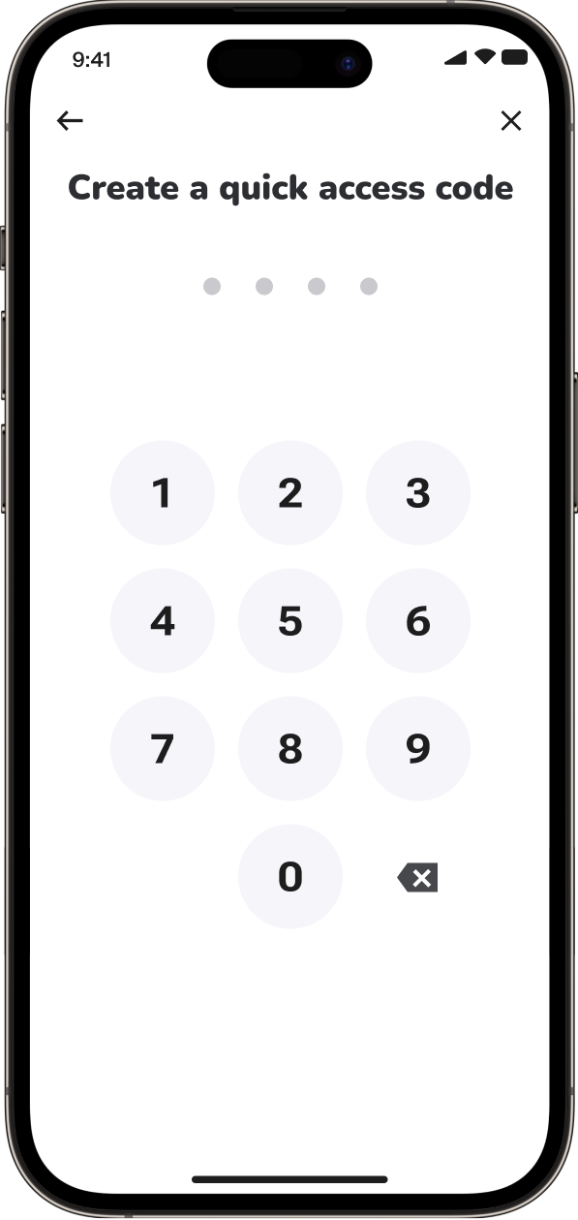
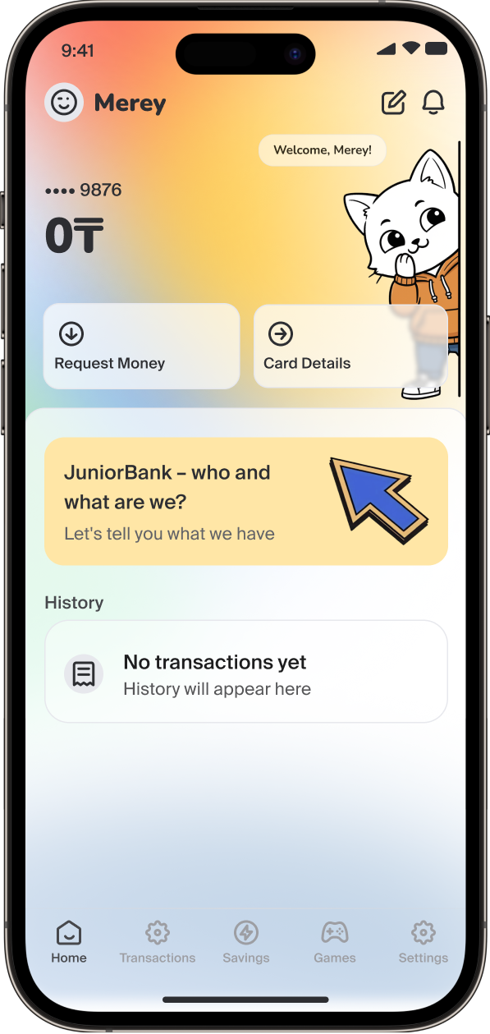
How a child can register in the JuniorBank app
Enter your phone number
Enter the SMS verification code
Create a password for the app
Create a quick access code
Done! Welcome to JuniorBank 🎉

Slide 5
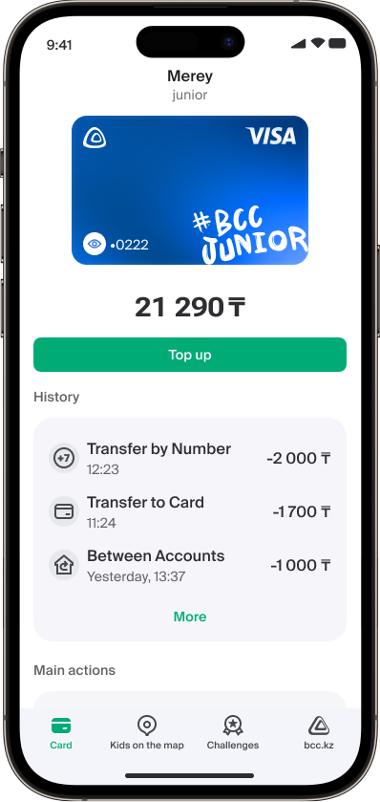
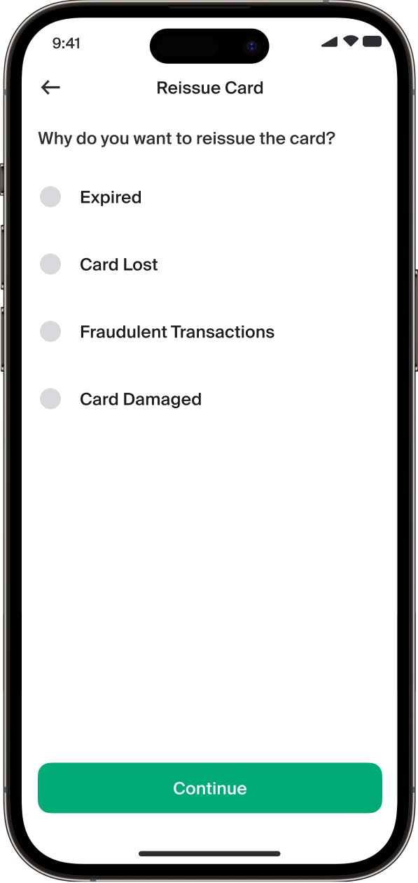
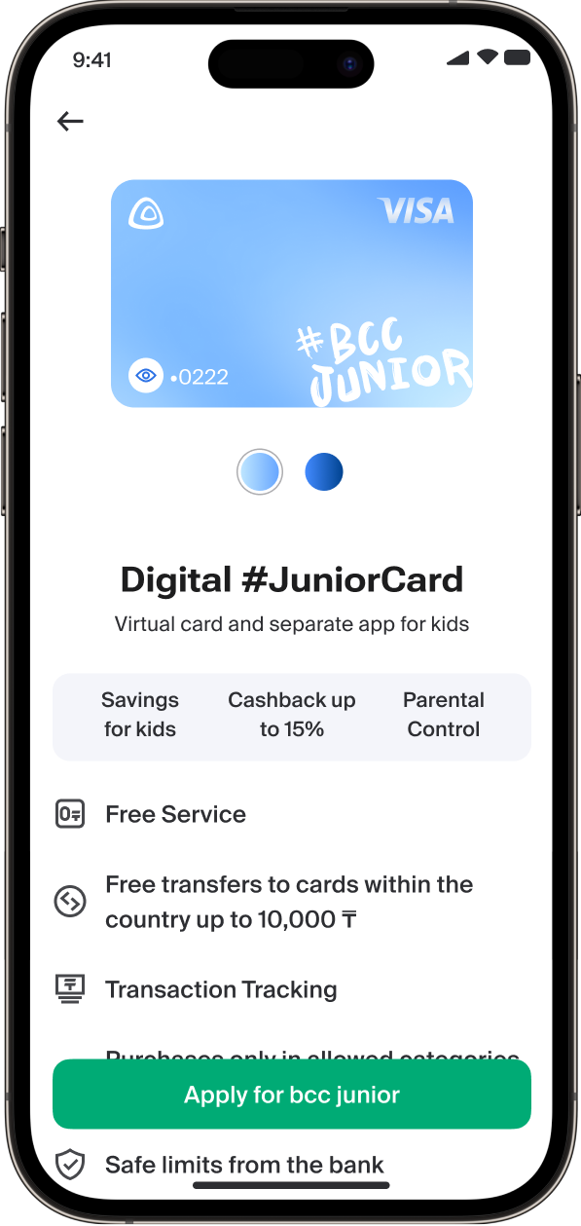
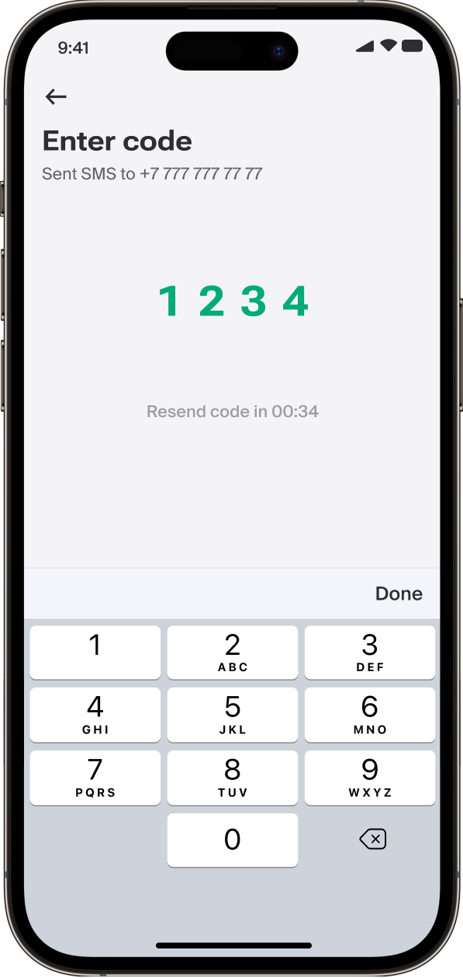

How to reissue a bcc junior card
Go to the JuniorBank module on the home screen and tap “Reissue card”
Select the reason for reissuing the card
A digital card can be reissued online, while a physical card can be reissued at a bank branch
Enter the SMS verification code
The card will be ready in the app within 5 minutes

Slide 6
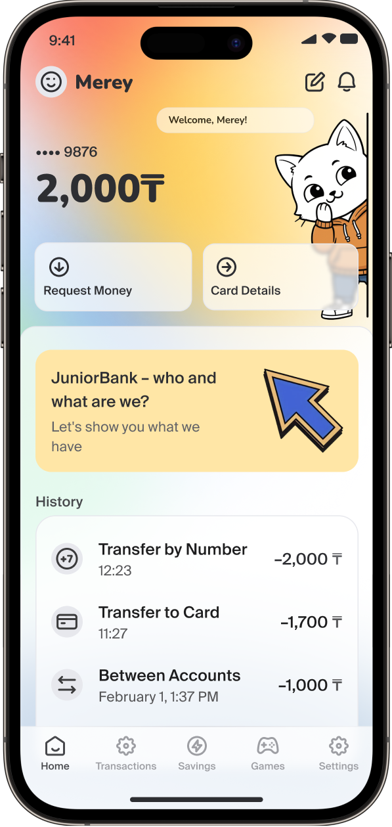
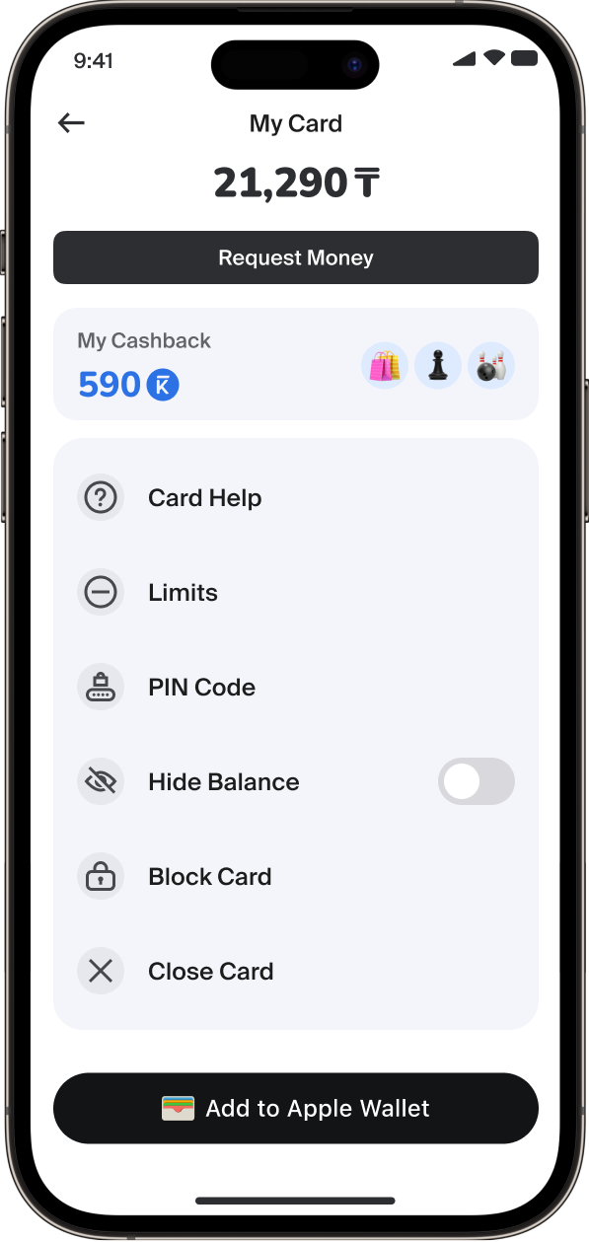
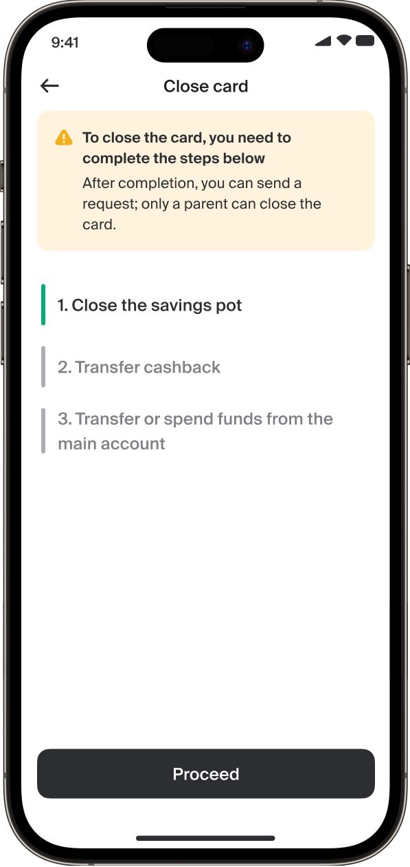
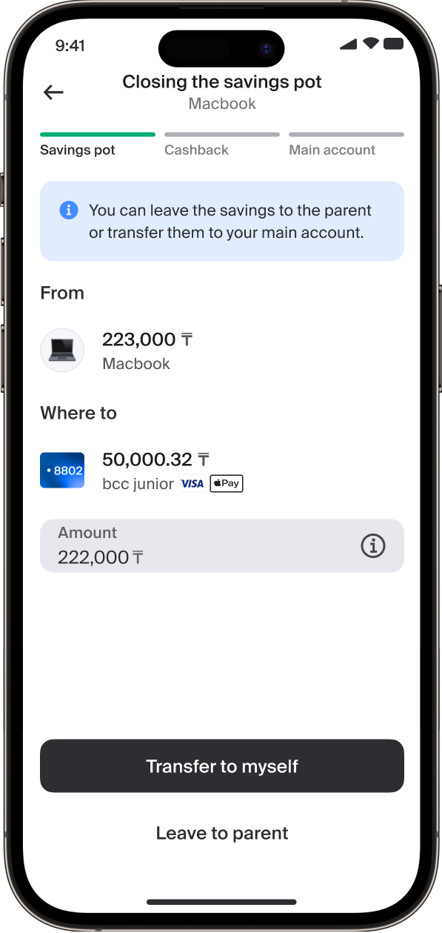
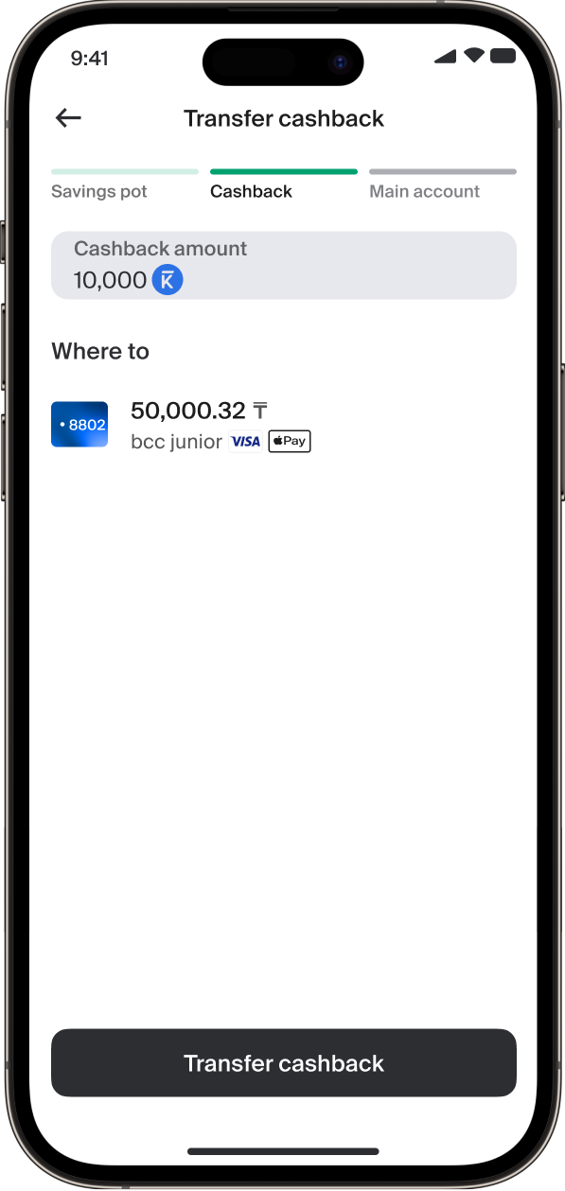
How to close a child’s card in JuniorBank
Tap on the card on the home screen
Select “Close card” from the list
Follow the steps shown on the screen
Follow the steps shown on the screen
Then transfer the cashback to the card

Slide 7
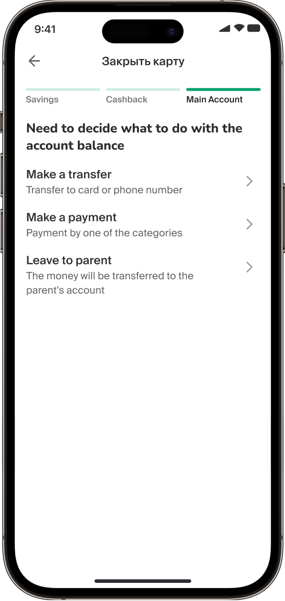
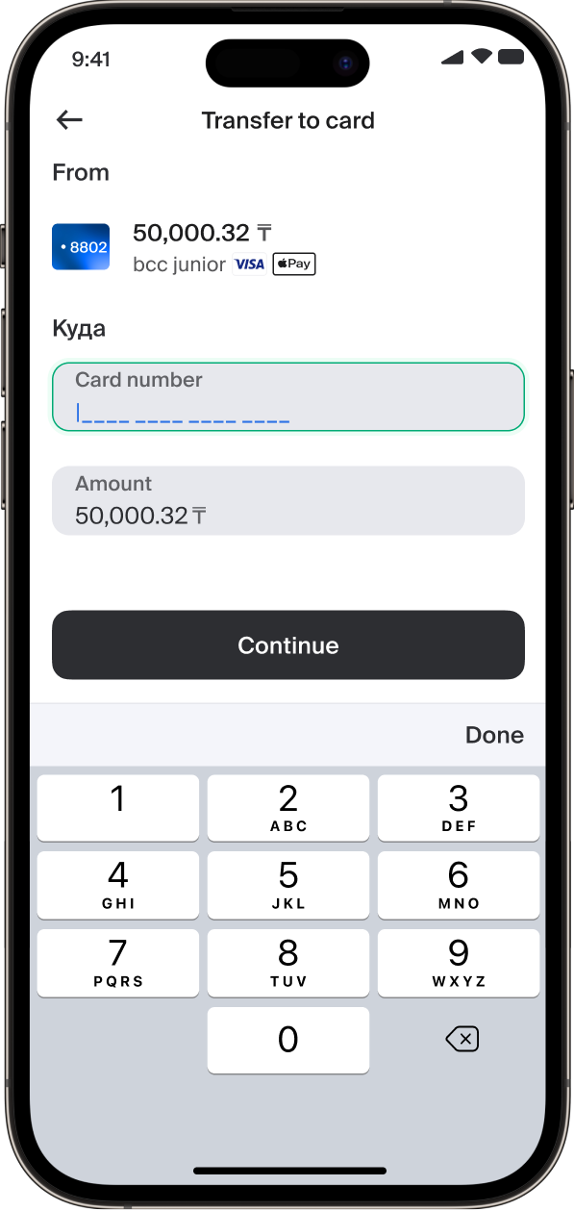
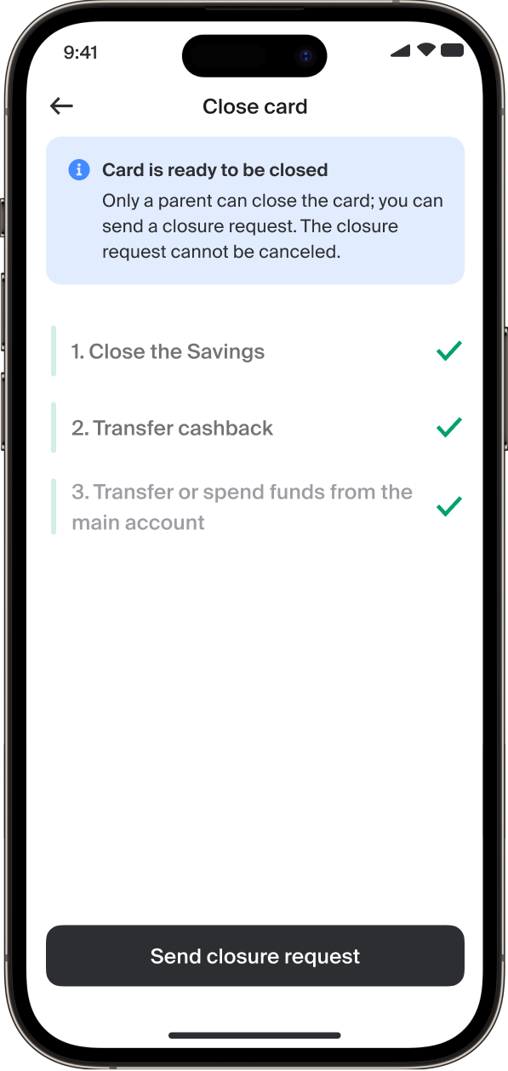
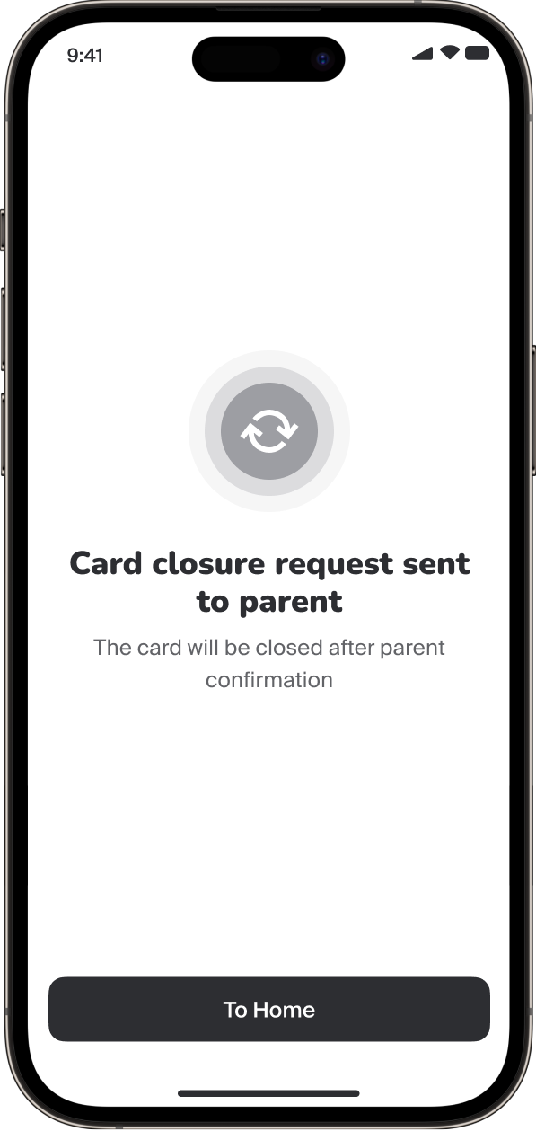
How to close a child’s card in the JuniorBank app
Decide what to do with the remaining balance on the account
Choose, for example, to transfer it to another card
Submit a request to close the card
Request sent! The card will be closed after parent confirmation

Slide 8
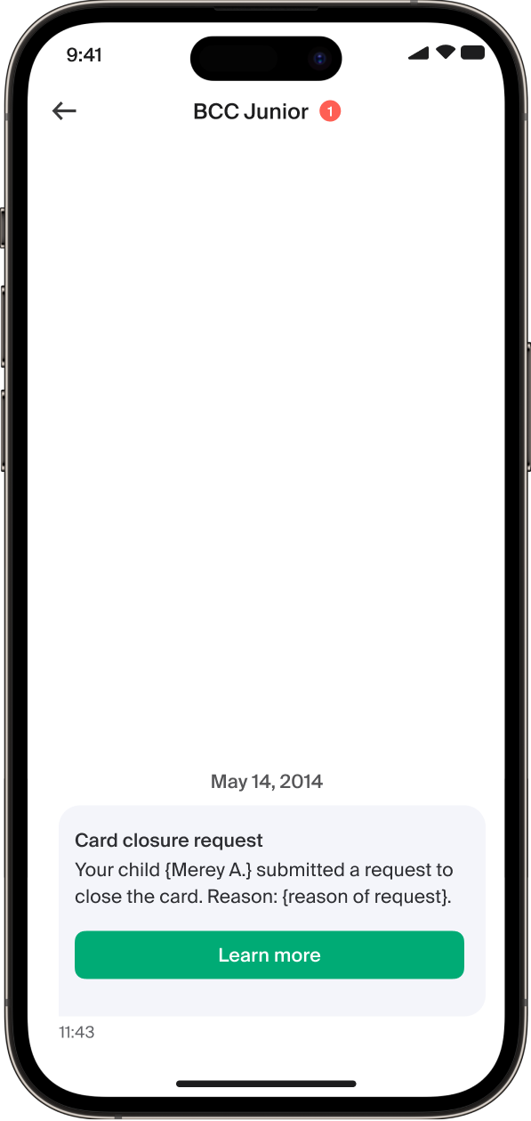
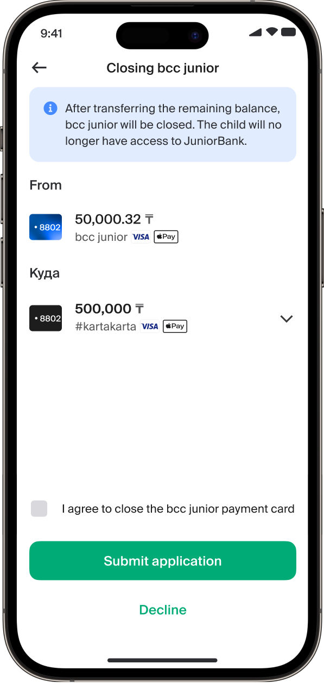
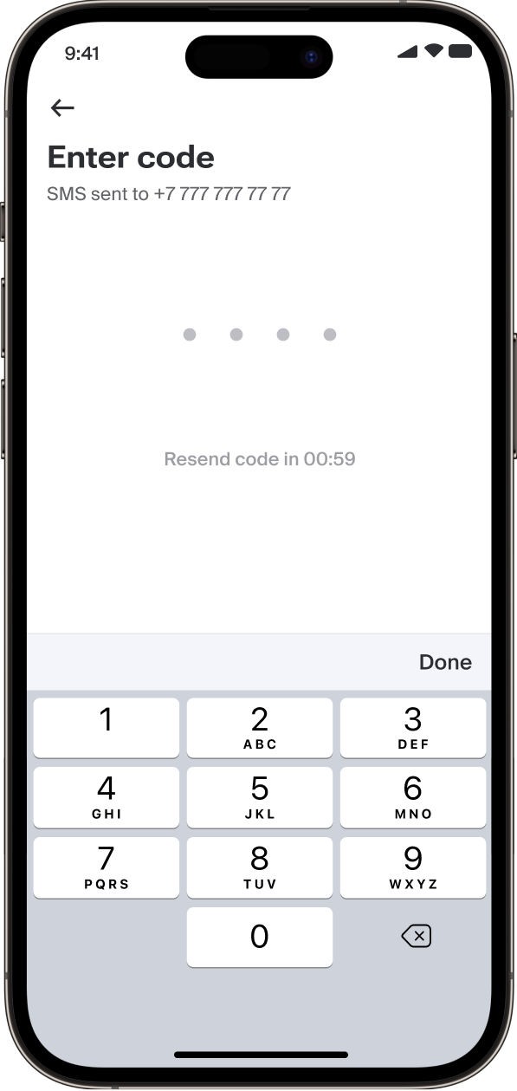
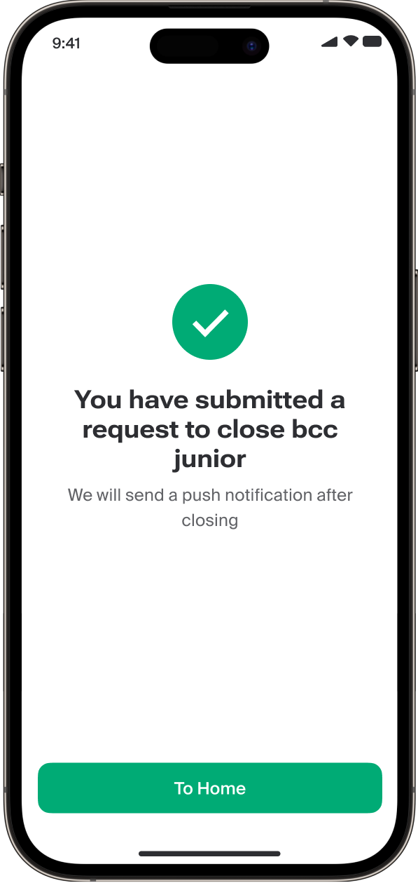
How to close a bcc junior card from the parent’s side
Tap “More details”
If there is a remaining balance on the card, transfer it to your own card
Enter the SMS verification code
After closing, you will receive a push notification

Slide 9
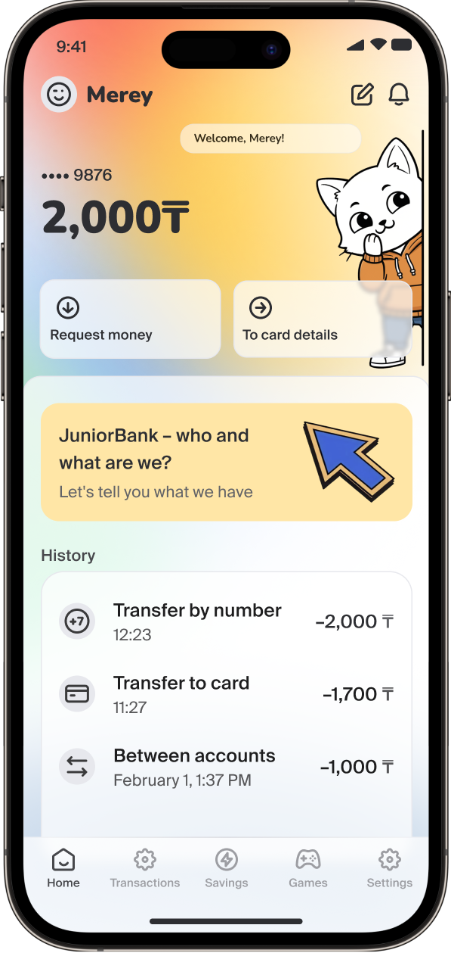
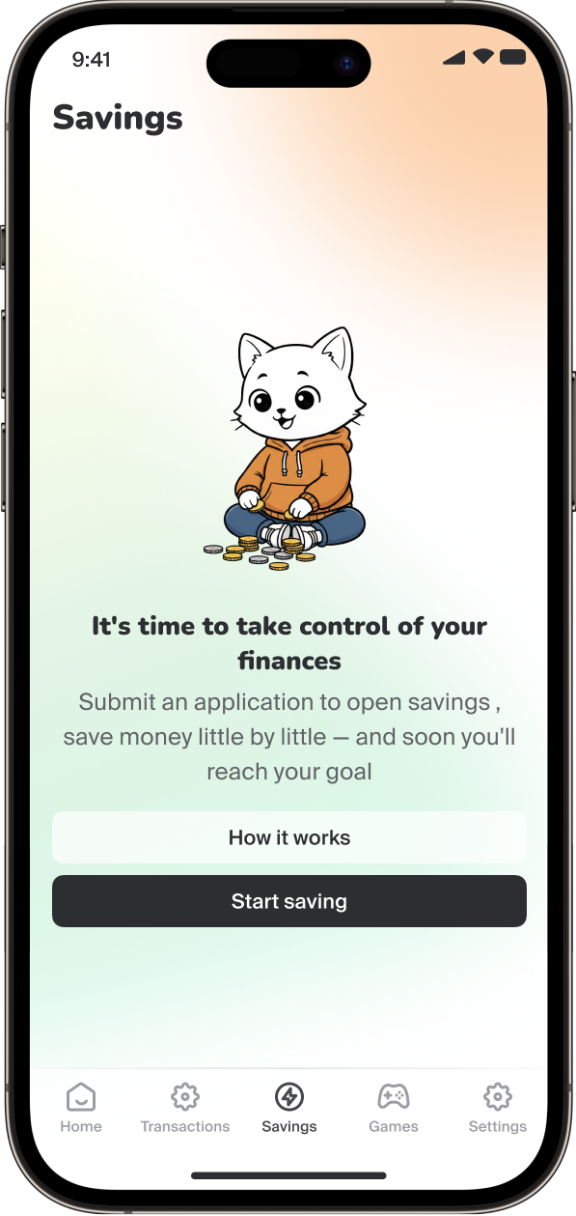
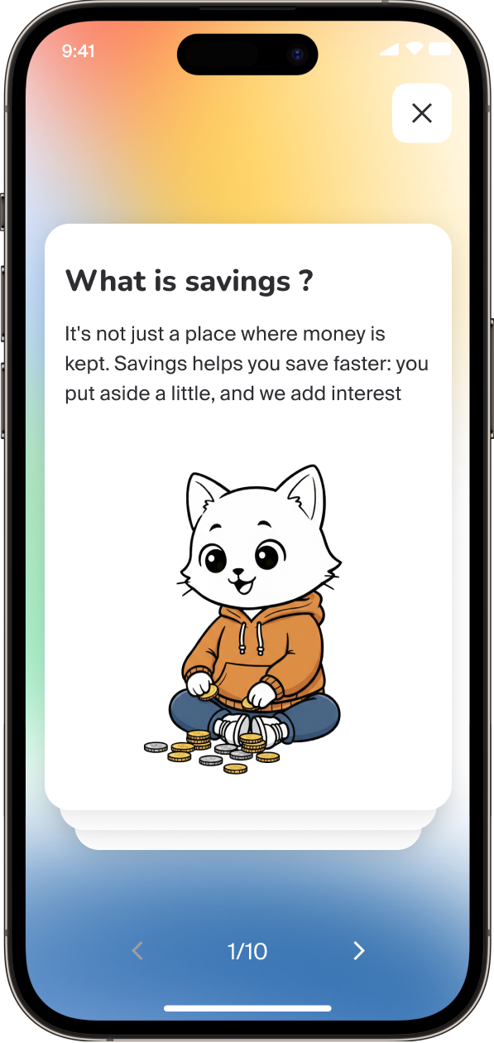
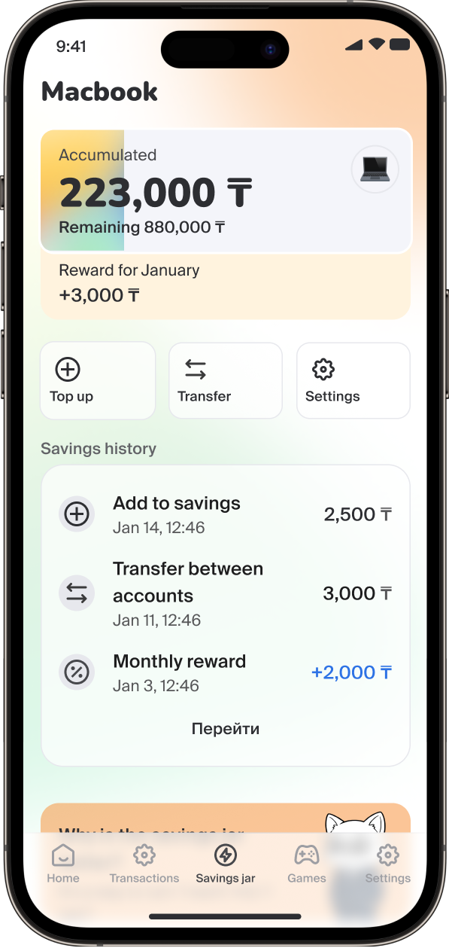
How to open an “Online Money-box posit
To open a money box bank, tap the banner on the home screen
Tap “Start saving”
УLearn more about how to save
Enter the amount you want to save — and you’re all set!

Slide 10
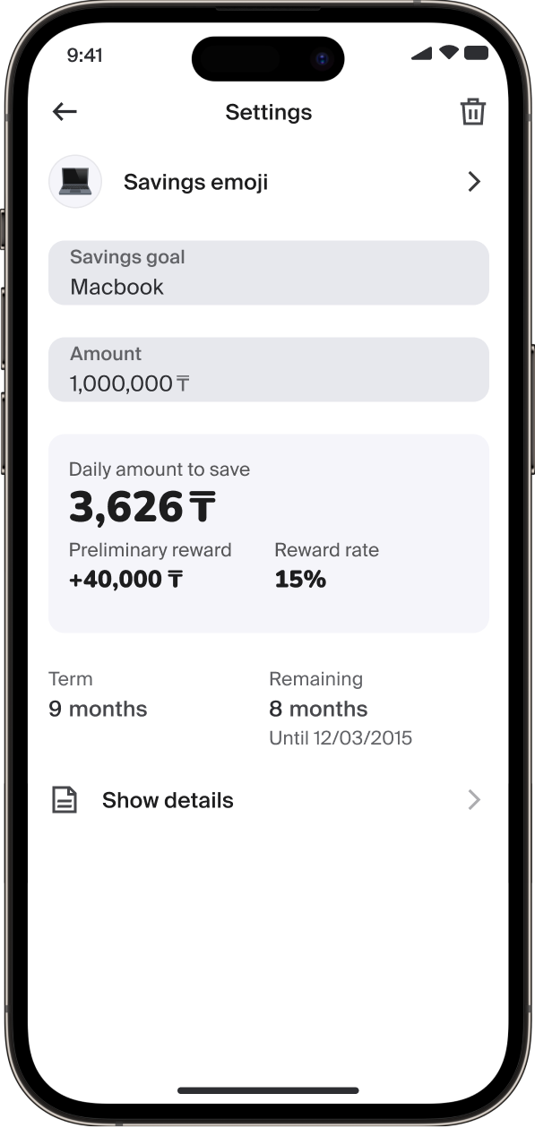
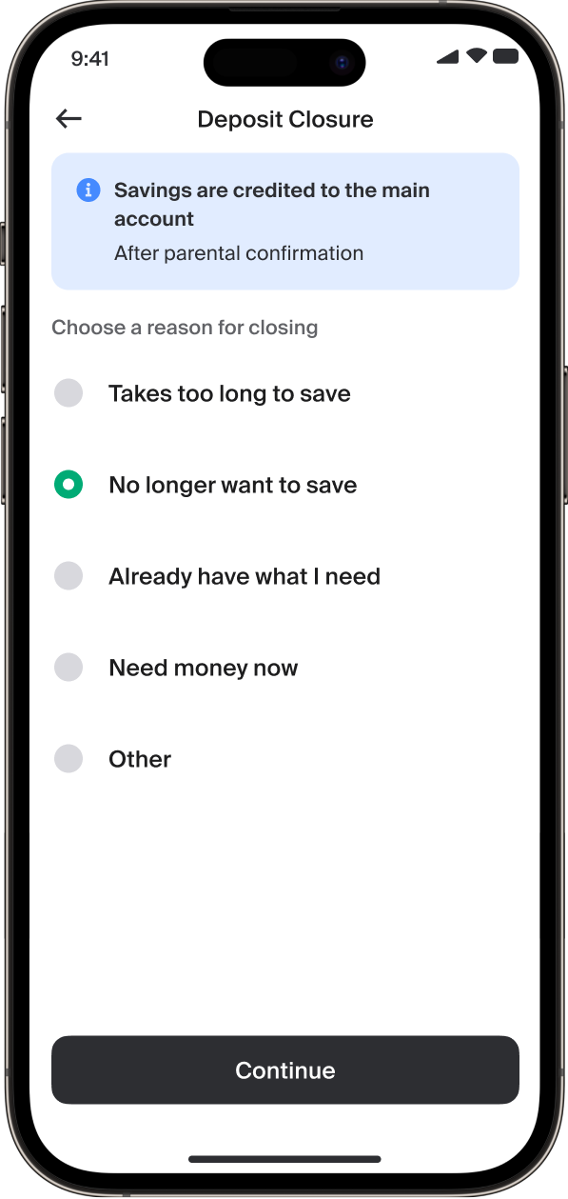
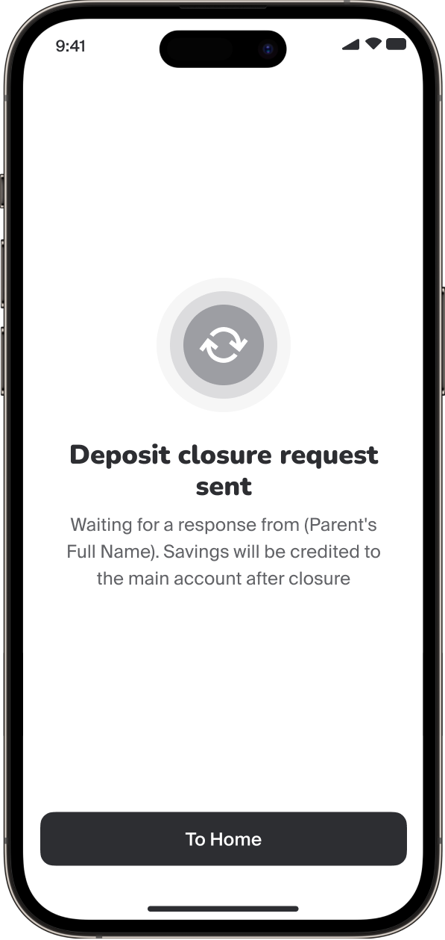
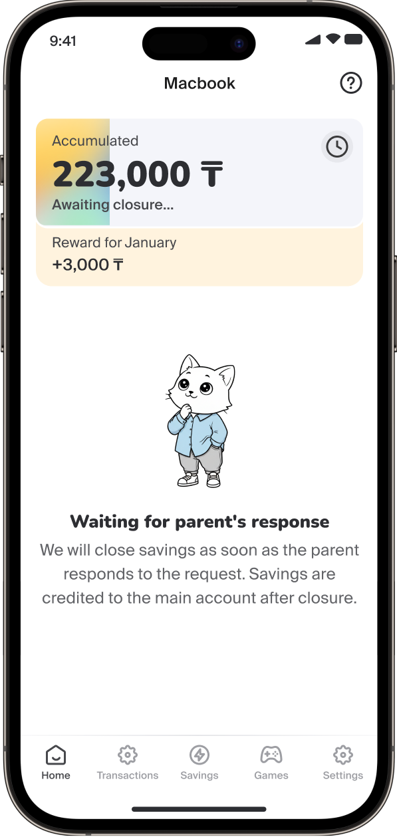
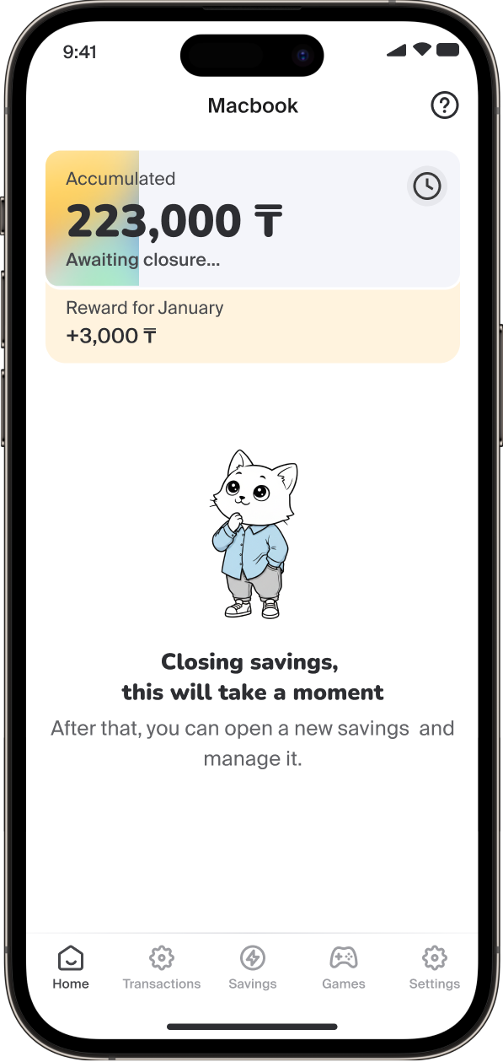
How to close the “Online money box” deposit
To close the piggy bank, tap Settings in the Deposit section, then tap the trash icon in the top right corner
Select the reason for closing
Then send the request for parent approval
Wait for the parent’s response
Request sent! The deposit will be closed after review

